Slide 1
Virtual Incident Procurement (VIPR)
May 2023 AK IMT Incident Finance Training
Amelia Velasco, PROC
Sean O’Neal, PROC

Slide 2
Virtual Incident Procurement (VIPR)
United States Department Agriculture (USDA), Forest Service (FS) is the only federal agency that uses VIPR, which is a web-based incident procurement system.
There are Incident Blanket Purchase Agreements (I-BPA’s) awarded throughout the United States. USDA, FS awards by region.

Slide 3
Forest Service Regions
https://www.fs.usda.gov/foresthealth/contact-us/regional-contacts.shtml
Notes:
Within each region there are multiple forests. Within each forest there are multiple district offices that we could be supporting if there is a fire large enough

Slide 4
Dispatch Centers
https://www.fs.usda.gov/business/incident/dispatchlookup.php?tab=tab_d

Slide 5
What is VIPR?
VIPR are not contracts, but Incident Blanket Purchase Agreements (I-BPA)
VIPR allows the Contracting Officers (COs) to create, award, and manage solicitations and agreements through an electronic procurement process.
VIPR provides numerous tools for COs to use for incident blanket purchase agreements (I-BPAs), including…
creation of solicitations and amendments,
collection and evaluation of offers,
electronic award and modification of agreements,
electronic management of contract files, and
creation of Dispatch Priority Lists (DPLs).

Slide 6
What is VIPR BPA?
An Incident Blanket Purchase Agreement (I-BPA) is not a binding contract. The orders placed against the I-BPA or ‘BPA Calls’ are the binding contract at time of order/dispatch. NO GUARANTEE OF WORK. NO FUNDING TIED TO I-BPA.
BPAs are established preseason to fulfill reoccurring needs during the fire season. VIPR BPAs are typically for a 5-year duration.
BPAs can be used by any of the Government’s Wildland Fire Cooperators, but it is OPTIONAL.
Notes:
For the 5-year duration we agree on the rates, location of the resources, and ensure the vendor’s resources meet the Government’s requirements. Each year the vendor is offered the opportunity to change dispatch center, equipment attributes (like or greater/cannot change type), and rates.
Cooperators (state and local governments) have the option of using BPAs instead of their own agreements.

Slide 7
What is VIPR BPA?
Each VIPR advertisement has multiple awards. Each Award is tied to a dispatch center.
Ranking is determined by software program within VIPR. Each “advantage” will be clearly listed within the solicitation.
When there is an incident, after Agency and Cooperator resources have been used, the local DPL of the closest dispatch center is then used in ranked order to contact contracted VIPR vendors.
Notes:
First point: Each dispatch center will have a ranked listing by resource called a Dispatch Priority Listing (DPL) produced by VIPR.
Second point: Ranking, The Best Value to the Government will be ranked higher.
Third point: If local DPL is exhausted, there is an OPTION to go to neighboring dispatch centers.

Slide 8
EXAMPLE OF A DPL
Phoenix Interagency Dispatch Center
Crew Carrier Bus
Published On: 04/12/2022 10:11:42
DPL - https://www.fs.usda.gov/business/incident/dispatch.php?tab=tab_d

Slide 9
What types of equipment fall under VIPR?
Notes:
Each type of equipment is not necessarily available for every region. Helpful website: https://www.fs.usda.gov/business/incident/dispatchlookup.php?tab=tab_d

Slide 10
When are solicitations issued?
Depends….
https://www.fs.usda.gov/business/incident/vipr.php?tab=tab_d
2023 Solicitations
Heavy Equipment: Dozers, Excavators & Transports
Fuel Tenders
Vehicle with Driver
Fallers
Mechanic with Service Truck
Mobile Laundry Units (National)
Medical Services (National)
Crew Carrier Buses (National)

Slide 11
VIPR changes for 2023
Heavy Equipment
No major changes for 2023
See Section E of the solicitation for technical evaluation submission requirements.
Fallers
(1) CHAPS. meeting USFS Specification 6170-4F, or later, or certified to NFPA 1977. One pair per person. Chaps or cut-resistant pants for chain saw use shall meet the requirements of ASTM F-1897 (current version). Chaps meeting Forest Service 6170-4 meet the ASTM standard and are acceptable. Chaps shall overlap boots at least 2”.
See Section E of the solicitation for technical evaluation submission requirements.

Slide 12
VIPR changes for 2023
Mechanic with Service Truck
D.2.3 – Minimum Requirements
(1) Code Reader – generic. Must have ability to read models from 1995-present, must have ability to accept software upgrades, must have ability to diagnose ABS (brakes)/SRS (Air bags)/Engine Symptoms, must be self-sustained device with built-in screen, buttons, and software. (No mobile devices as screen), must have universal compatibility with many makes/models, must contain all power source and data cables required to function correctly.
D.3.1 – REPAIRS
Repairs shall be made and paid for by the Contractor. The Government may, at its option, elect to make such repairs when necessary to keep the resource operating. The cost of such repairs will be $90 $100 per hour, plus parts and will be deducted from payment to the contractor.
See Section E of the solicitation for technical evaluation submission requirements.

Slide 13
VIPR changes for 2023
Fuel Tenders
(a) There will be no Double Shift paid under this agreement. Agency personnel at the Section Chief level may, by resource order, authorize additional operators if needed during the assignments. Additional operators, when ordered will be paid a daily rate of $500 per operator.
See Section E of the solicitation for technical evaluation submission requirements.

Slide 14
VIPR changes for 2023
Vehicle with driver
D.2.1.1 – Contractor Provided Equipment
(a) Vehicles shall be equipped with a spare tire (see below), wheel wrench and jack.
(b) Vendor must provide tie downs, straps, netting to secure the load.
See Section E of the solicitation for technical evaluation submission requirements.

Slide 15
VIPR changes for 2023
No Major Changes
Mobile Laundry
Crew Carrier Buses
See Section E of the solicitation for technical evaluation submission requirements.

Slide 16
How to look up VIPR contracts
Go to: www.fs.usda.gov/business/incident/vipragreements.php?tab=tab_d
Notes:
Follow link to go to VIPR lookup site and this is the site that will provided a copy of the entire contract. This would be needed if there are any question regarding the terms and conditions of the contract. For example, lodging, double shift, etc. A specific example would be grantee transports being retained; however, fail to include second operator name.

Slide 17
VIPR Finance Copies
Same process as looking up entire vendor contract.
Provides most necessary information for finance.
Much smaller document to file in Teams or Sharepoint.
Notes:
Click on the site to go to the finance copy page.

Slide 18
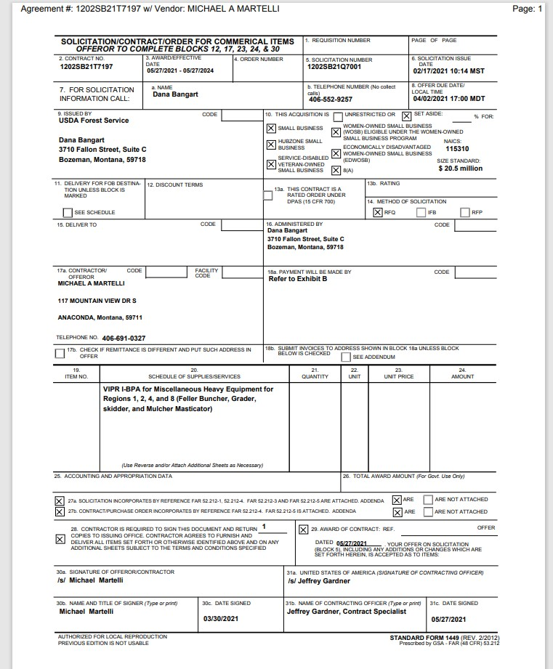

Slide 19
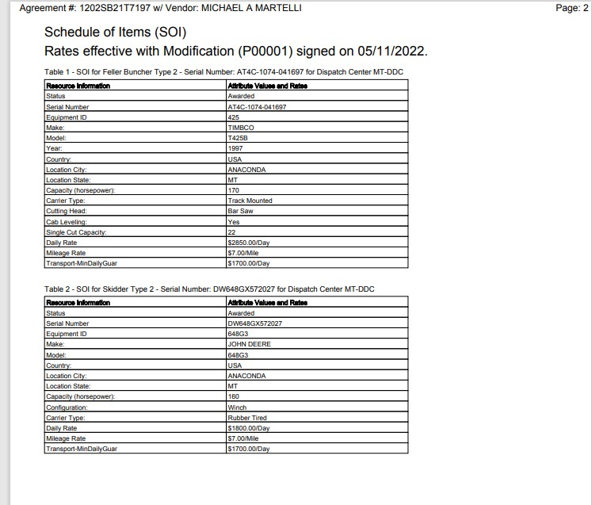

Slide 20
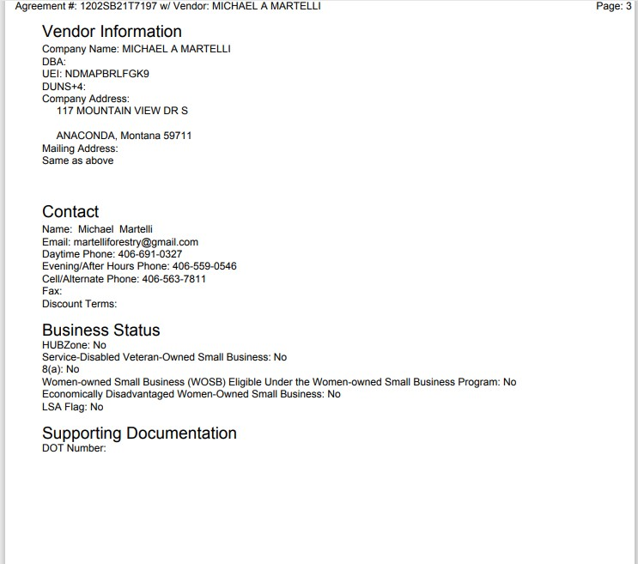

Slide 21
Other Agreement Types
Emergency Equipment Rental
Agreement (EERA)
Land Use Agreement
(LUA)
An agreement written at an incident using an EERA, OF-294.
The duration is for the length of the incident only.
Used for equipment
Land Use Agreement (LUA)
An agreement written at an incident using an Emergency Facilities & Land Use Agreement, PMS-902-2.
The duration is for the length of the incident only.
Used for land and facilities

Slide 22
Land Use Agreements (LUA)

Slide 23
Land Use Agreements (LUA)

Slide 24
Land Use Agreements (LUA)
Notes:
Government agent could be anyone with the authority to sign. Does not have to be a CO.

Slide 25
Emergency Equipment Rental Agreements(EERA)

Slide 26
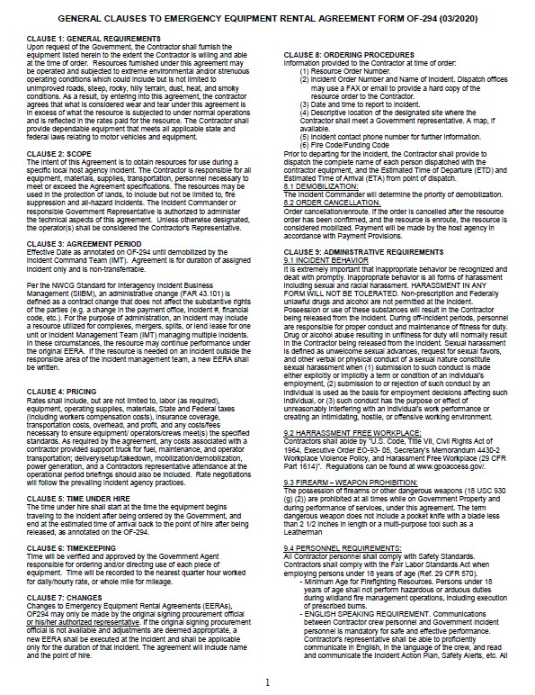
Emergency Equipment Rental Agreements(EERA)

Slide 27
VIPR contract or an EERA/LUA Agreement?
VIPR
EERA/LUA
Agreement #1202SB21T7197
12 – Agency
0323 – Procurement Office Code
21 – Fiscal Year
T – Contract Mechanism
7197 – Unique Identifier
T – Contract (VIPR)
Agreement #1202RZ23K5042
12 – Agency
02RZ – Procurement Office Code
23 – Fiscal Year
K – Contract Mechanism
5042 – Unique Identifier
K – Agreement(EERA)

Slide 28
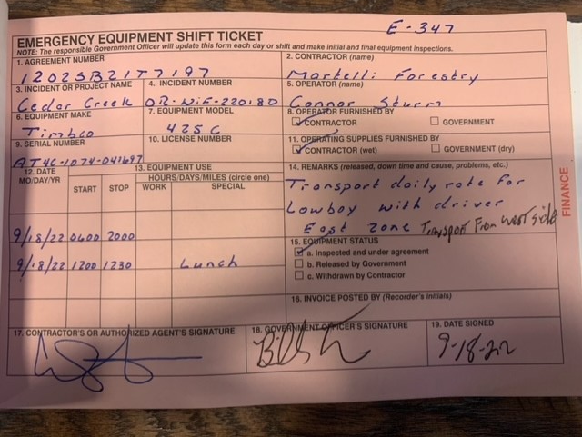
VIPR or EERA?
Notes:
Ensure both operator names are listed in box 5 or remarks section of shift ticket

Slide 29
VIPR or EERA?
Notes:
Any issues with this shift ticket? No lunch recorded.

Slide 30
At-Incident Management Support (AIMS)
Preseason I-BPA agreements
Toilets/handwash, tents, ATV/UTV
Used before EERA’s
AIM’s Dispatch Priority List
Duty Phone
(720) 473-4105 regular and after hours
All guidance questions are sent to..
SM.FS.WOAIMS@usda.gov
Can also send ROs and GM to this inbox
Notes:
If there is no IMT assigned to an incident then you contact AIMS

Slide 31
Vendor Key Links
Announcements to Vendors. Lists current announcements that affect Vendors who are using the VIPR Vendor Solution.
Forest Service Incident Procurement VIPR Web site. Provides incident procurement information and tools to all current and potential Vendors—not just Vendors who will use VIPR.
VIPR Vendor Application Provides key information about the vendor application, as well as login access to the application.
System for Award Management (SAM). Provides instructions for registering with SAM. Also lists the VIPR I-BPA competitive solicitation opportunities.
Contractor Quick Start Guide for SAM.gov: Finding Opportunities Assists contractors using FBO.gov with their transition to beta.SAM.gov. This document will provide an overview of searching for contract opportunities, following contract opportunities and signing up for an Interested Vendor List.
Procurement Technical Assistance Centers (PTACs). Local resource available that can provide assistance to business firms in marketing products and services to the Federal, state, and local governments at no or nominal cost.
Interagency Incident Applications Helpdesk Provides support for VIPR and other incident related applications.

Slide 32
Crews
National Type 2 & Type 2 Initial Attack Firefighting Crews Contracts
Payment
Resource Order, CTR’s (SF-261) signed by the Government Representative
lodging receipts (if applicable)
Emergency Equipment Use Invoice (OF-286) signed by the Contractor’s Representative AND Government Representative.
Please note, a copy of the contract is not required to be submitted to ASC with the invoice. ASC has copies of all the contracts including DUNS and TAX ID numbers.

Slide 33
Type 2 Initial Attack (IA)
Type 2 IA Hand Crew Minimum Requirements
Minimum 18 personnel, Maximum 20
Crew Boss (CRWB)
3 Type 5 Incident Commanders (ICT5)
60% of the crew with at least 1 season experience
Can be broken into squads.
4 programmable radios
3 sawyers (1 FAL2, 2 FAL3)
Available Nationally
Notes:
Stress that contract crews are typically handled on the equipment side. Federal crews are handled on the time side.

Slide 34
Type 2 Hand Crew
Type 2 Hand Crew Minimum Requirements
Minimum 18 personnel, Maximum 20
Crew Boss (CRWB)
3 FFT1
20% of the crew with at least 1 season experience
Can not be broken into squads.
4 programmable radios
No sawyers
Availability varies

Slide 35
Transport Pay Matrix
Notes:
Handy reference to help with calculating transport pay

Slide 36
VIPR Quick Reference Guide 2023
GENERAL | PAYMENTS
VIPR Contact List | OF-286 Use Invoice Example and How-to
VIPR Agreement Look-up | Procurement Unit Leader Field Guide
DPL Look-up | Transport Payments
Shift Ticket Example and How-to | FS Incident Payment Guide
Inspection Compliance Forms; Standard Method of Hire | RX Fire
VIPR Solicitation Cycle | VIPR Solicitation Templates
AIMs Operating Guidelines & DPLs | RX Fire
Secondary Source List_Sign Up_ (AIMS); Vendor resources not signed up on IBPA | IBPA Policy
Resource Typing Guide | State Payment POCs
IROC Self Status Video for Vendors | IBPA Key Links
I-BPA Performance Review | SIIBM & Associated Forms
Performance Review Submittal Link | National Contracts
Notes:
These are links to VIPR information. We will provide the file.

Slide 37
Contact Information:
Amelia Velasco
amelia.velasco@usda.gov
208-569-8238
Sean O’Neal
sean.oneal@fdacs.gov
352-425-1915
Notes:
These are links to VIPR information. We will provide the file.

